Slide 1
God
The Theme of Representation
Family
Man
Beasts

Slide 2
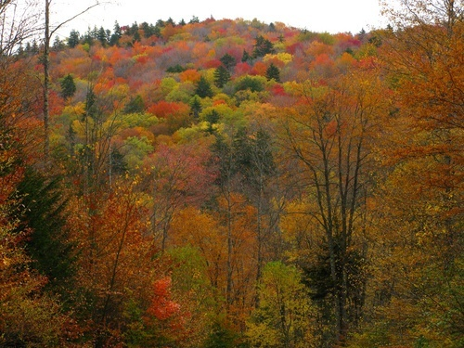
God
The Theme of Representation
Family
Man
Beasts
Autumn Colors Mountains; www.forestwander.com

Slide 3
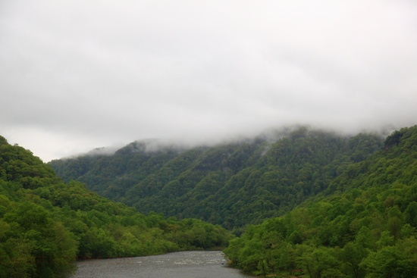
Psalm 2 written
New Testament written
Adam
Abraham 2000BC
Moses 1450BC
David 1000BC
Jesus AD30
Us AD2000
Jesus Returns
Psalm 2 Theology
Psalm 2 Influence
Psalm 2 Content
New River Mountains Fog; www.forestwander.com

Slide 4
Matthew
Mark
Luke
Acts
Romans
1 Corinthians
Ephesians
Colossians
Hebrews
1 Peter
Psalm 110’s Influence:
New River Mountains Fog; www.forestwander.com

Slide 5
God
God’s purpose for mankind:
† We are to reflect God’s image.
† We are to represent God here.
What God has revealed of his plan has changed, but this purpose has not.
Christ uniquely fulfills God’s purpose, but we play a part.
Family
Man
Beasts

Slide 6
Genesis 1.26-28 NET: Then God said, “Let us make humankind in our image, after our likeness, so they may rule over the fish of the sea and the birds of the air, over the cattle, and over all the earth, and over all the creatures that move on the earth.” ²⁷ God created humankind in his own image, in the image of God he created them, male and female he created them. ²⁸ God blessed them and said to them, “Be fruitful and multiply! Fill the earth and subdue it! Rule over the fish of the sea and the birds of the air and every creature that moves on the ground.”

Slide 7
God’s Covenant with Adam in Creation
A. People should reflect God’s character.
B. People should represent God and rule over creation.
C. There was a chain of command:
† God ruled over man.
† Man represented God and ruled in God’s name over the human family.
† Man with the human family represented God and ruled in God’s name over the rest of the world.
God
Family
Man
Beasts

Slide 8
Genesis 3
The devil, in the guise of a snake,
influenced the woman;
the woman influenced the man;
the man disobeyed God,
so all was topsy turvy.
The results were bad:
† The devil ruled the Earth.
† The Earth was cursed.
† People now were separated from God.
† People now were corrupted in nature.
God
Family
Man
Beasts

Slide 9
Genesis 3.15 HCSB: “I will put hostility between you and the woman, and between your seed and her seed. He will strike your head, and you will strike his heel.”
God promised that one man [seed of the woman] would someday conquer Satan and deliver people and the Earth from the effects of sin. He would be the Deliverer.
One man would someday fulfill the original intention for all people, reflecting the image of God and representing God by ruling in his name.
God
Family
Man
Beasts

Slide 10
Genesis 12.1-3 NIV: The LORD had said to Abram, “Go from your country, your people and your father's household to the land I will show you. ² I will make you into a great nation, and I will bless you; I will make your name great, and you will be a blessing. ³ I will bless those who bless you, and whoever curses you I will curse; and all peoples on earth will be blessed through you.”
God
God
Family
Man
Israel
King
Beasts
Nations

Slide 11
God’s Covenant with Abraham
Genesis 12-50
God promised Abraham...
God would bless and protect his family;
God would make his family into a great nation; and
Through this nation, God would bless all the families of the Earth.
God
God
Family
Man
Israel
King
Beasts
Nations

Slide 12
God’s Covenant with Abraham
A. Israel was to reflect God’s character.
B. Israel was to represent God and rule over the nations.
C. There was a chain of command:
† God was over the King.
† The King represented God and ruled in God’s name over Israel.
† The King with Israel represented God and ruled in God’s name over the rest of the world.
God
God
Family
Man
Israel
King
Beasts
Nations

Slide 13
God
God
Family
Man
Israel
King
Beasts
Nations
Similar Covenants... and similar problems...

Slide 14
In Exodus - Deuteronomy, Moses was the man God placed over the nation [though he was not called a king], to equip the nation to represent God well. The people often rebelled.
After Moses, Joshua ruled the people. Again, there was rebellion [Joshua].
When Joshua died, various Judges and then Saul, the first king, ruled, but the people often rebelled [Judges, Ruth, 1 Sam.].
God
Israel
King
Nations

Slide 15
2 Samuel 7:12-16 [NASB]: “When your days are complete and you lie down with your fathers, I will raise up your descendant after you, who will come forth from you, and I will establish his kingdom. He shall build a house for My name, and I will establish the throne of his kingdom forever. I will be a father to him and he will be a son to Me; when he commits iniquity, I will correct him with the rod of men and the strokes of the sons of men, but My loving-kindness shall not depart from him, as I took it away from Saul, whom I removed from before you. Your house and your kingdom shall endure before Me forever; your throne shall be established forever.”
God
Israel
King
Nations

Slide 16
In 2 Samuel, David became King. God made a covenant with David too, and it had all the important elements:
reflecting God’s character
B. representing God, ruling in his name
C. obeying the chain of command
D. the promised Deliverer who [God revealed] would come through David and be a King of Israel
God
Israel
King
Nations

Slide 17
God
Colossians 1.15 NIV: “The Son is the image of the invisible God, the firstborn over all creation.”
Jesus is the one perfectly pure man who is also divine: he fulfills the goal of having a leader of the human race to represent God the Father and reflect God’s image.
After the resurrection, believers will be fully transformed to the character of Christ and able to reflect and represent God the Father on Earth.
Family
Man
Beasts

Slide 18
Luke 1.32-33 NIV: “...The Lord God will give him the throne of his father David, and he will reign over Jacob's descendants forever; his kingdom will never end.”
Christ is the anointed eternal King of Israel, fulfilling the need for a righteous king to reflect God’s image and represent God in leadership on Earth.
When Christ returns, he will rule Israel and through Israel over the nations.
God
Israel
King
Nations
Matthew 25.31 NET: “When the Son of Man comes in his glory and all the angels with him, then he will sit on his glorious throne.”

Slide 19
1 Peter 2.9 NET: “But you are a chosen race, a royal priesthood, a holy nation, a people of his own, so that you may proclaim the virtues of the one who called you out of darkness into his marvelous light.”
In this time period, Jesus represents God the Father as head of the Church, and we follow him as our leader, seeking to reflect God’s character and represent God to all the people of the world.
God
Church
Jesus
People

Slide 20
John 6.40 NET [Jesus speaking]: “For this is the will of my Father– for everyone who looks on the Son and believes in him to have eternal life, and I will raise him up at the last day.”
To be saved into the people of God, one has to believe in God’s promise of a gift of deliverance through Christ. Salvation is by grace through faith.
Ephesians 2.8 NET: For by grace you are saved through faith, and this is not from yourselves, it is the gift of God.
God
Church
Jesus
People

Slide 21
1. God’s purpose has been to create a people who would reflect his character and represent him well on Earth.
2. God wants us to follow Christ, experience transformation in character, and learn to live transformed lives. Our goal each day should be to reflect God’s character and represent him well.
3. Christ is the key to fulfilling God’s three plans for achieving his purpose. He is God the Father’s top representative in each model and will gather his people.
God
Church
Jesus
People

Slide 22
God
The Theme of Representation
Family
Man
Beasts

